Slide 1
C++ Basics

Slide 2
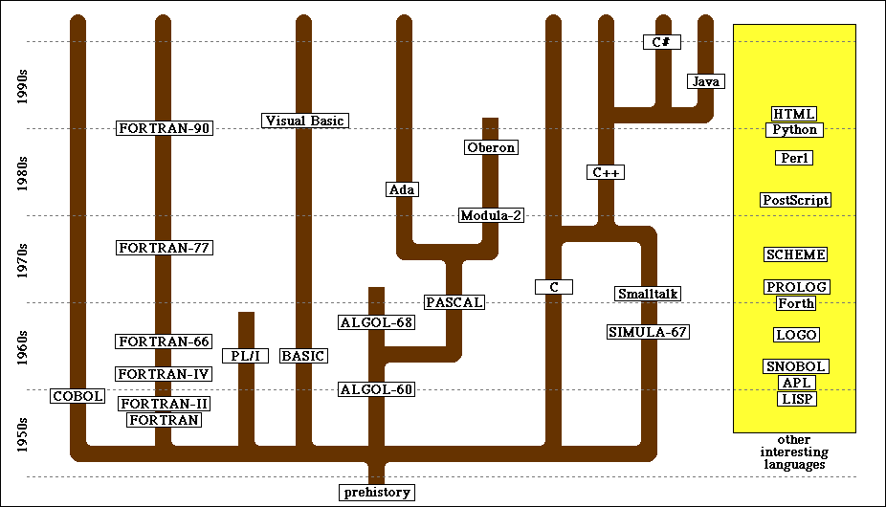
The History of C++

Slide 3



“Hello World”
/*
* File: HelloWorld.cpp
*/
#include <iostream>
using namespace std;
int main() {
cout << "hello, world" << endl;
return 0;
}
comments
library inclusions
main program
C++ is backwards compatible with C. C programs should compile in C++; some may require minimal changes.
New compiler: g++ HelloWorld.cpp

Slide 4
The Compilation Process
source file
object file
/*
* File: HelloWorld.cpp
* --------------------
* This file is adapted from
* Kernighan and Ritchie's book
* The C Programming Language.
*/
#include <iostream>
using namespace std;
int main() {
cout << "hello, world" << endl;
return 0;
}
110100110111001011101110001110011
111000000100001110000001101111100
100010101110100100010001100110111
110001001010111010010110110001011
101101111101110111111011001101101
111001110001111111010001111100011
111100111110101111011101000011110
110111010000111111010100111001011
101111011111010111011111101000101
110111100110111010000111000111110
101010000111100111001010001001101
101101011101110111010111100010011
111111111100111111001001110110110
110101110011111100011010100100001
compiler
executable file
110100110111001011101110001110011
111000000100001110000001101111100
100010101110100100010001100110111
110001001010111010010110110001011
101101111101110111111011001101101
111001110001111111010001111100011
111100111110101111011101000011110
110111010000111111010100111001011
101111011111010111011111101000101
110111100110111010000111000111110
101010000111100111001010001001101
101101011101110111010111100010011
111111111100111111001001110110110
110101110011111100011010100100001
110100110111001011101110001110011
111000000100001110000001101111100
100010101110100100010001100110111
110001001010111010010110110001011
101101111101110111111011001101101
111001110001111111010001111100011
111100111110101111011101000011110
110111010000111111010100111001011
101111011111010111011111101000101
linker
library file
110100110111001011101110001110011
111000000100001110000001101111100
100010101110100100010001100110111
110001001010111010010110110001011
101101111101110111111011001101101
111001110001111111010001111100011
111100111110101111011101000011110
110111010000111111010100111001011
101111011111010111011111101000101
110111100110111010000111000111110
101010000111100111001010001001101
101101011101110111010111100010011
111111111100111111001001110110110
110101110011111100011010100100001

Slide 5
The Structure of a C++ Program
/*
* Function: raiseToPower
* Usage: int p = raiseToPower(n, k);
* ----------------------------------
* Returns the integer n raised to the kth power.
*/
int raiseToPower(int n, int k) {
int result = 1;
for (int i = 0; i < k; i++) {
result *= n;
}
return result;
}
/*
* File: PowersOfTwo.cpp
* ---------------------
* This program generates a list of the powers of
* two up to an exponent limit entered by the user.
*/
#include <iostream>
using namespace std;
/* Function prototypes */
int raiseToPower(int n, int k);
/* Main program */
int main() {
int limit;
cout << "This program lists powers of two." << endl;
cout << "Enter exponent limit: ";
cin >> limit;
for (int i = 0; i <= limit; i++) {
cout << "2 to the " << i << " = "
<< raiseToPower(2, i) << endl;
}
return 0;
}
/*
* File: PowersOfTwo.cpp
* ---------------------
* This program generates a list of the powers of
* two up to an exponent limit entered by the user.
*/
#include <iostream>
using namespace std;
/* Function prototypes */
int raiseToPower(int n, int k);
/* Main program */
int main() {
int limit;
cout << "This program lists powers of two." << endl;
cout << "Enter exponent limit: ";
cin >> limit;
for (int i = 0; i <= limit; i++) {
cout << "2 to the " << i << " = "
<< raiseToPower(2, i) << endl;
}
return 0;
}
program comment
function comment
library inclusions
function definition
function prototype
main program

Slide 6
Variables
Variable: a named location for storing a value.
In C++, you must declare a variable before you can use it. The declaration establishes the name, type, and sometimes the initial value as well.
type name;
type name = value;
Local variables: declarations as statements in the body of a method definition. Variables declared in this way are called and are accessible only inside that method.

Slide 7
Data Types
C++ defines a set of primitive types to represent simple data.
int
This type is used to represent integers, which are whole numbers such as 17 or –53.
double
This type is used to represent numbers that include a decimal fraction, such as 3.14159265.
bool
This type represents a logical value (true or false).
char
This type represents a single ASCII character.
Many data types are represented using objects or other compound structures containing primitive types.

Slide 8
Expressions in C++
int total = n1 + n2;
The n1 + n2 is an example of an expression, which specifies the operations involved in the computation.
An expression in C++ consists of terms joined together by operators.
Each term must be one of the following:
A constant (such as 3.14159265 or "hello, world")
A variable name (such as n1, n2, or total)
A method call that returns a value (such as someFunction())
An expression enclosed in parentheses

Slide 9
Terms in an Expression
The simplest terms that appear in expressions are constants (does not change) and variables (can change).
A variable in C++ is most easily envisioned as a box capable of storing a value.
The format of a constant depends on its type:
Integral constants consist of a string of digits, optionally preceded by a minus sign, as in 0, 42, -1, or 1000000.
Floating-point constants include a decimal point, as in 3.14159265 or 10.0. Floating-point constants can also be expressed in scientific notation by adding the letter E and an exponent after the digits of the number, so that 5.646E-8 represents the number 5.646 x 10⁻⁸.
The two constants of type boolean are true and false.
Character and string constants will be discussed soon. For the moment, all you need to know is that a string constant consists of a sequence of characters enclosed in double quotation marks, such as "hello, world".
total
42
(contains an int)
Each variable has the following attributes:
A name, which enables you to differentiate one variable from another.
A type, which specifies what type of value the variable can contain.
A value, which represents the current contents of the variable.
The name and type of a variable are fixed. The value changes whenever you assign a new value to the variable.

Slide 10
Operators and Operands
Arithmetic expressions
+
Addition
*
Multiplication
–
Subtraction
/
Division
%
Remainder
Operators in C++ usually appear between two subexpressions, which are called its operands. Operators that take two operands are called binary operators.
The - operator can also appear as a unary operator, as in the expression -x, which denotes the negative of x.

Slide 11

The Pitfalls of Integer Division
Consider the following C++ statements, which are intended to convert 100˚ Celsius temperature to its Fahrenheit equivalent:
double c = 100;
double f = 9 / 5 * c + 32;
The computation consists of evaluating the following expression:
9 / 5 * c + 32
The problem arises from the fact that both 9 and 5 are of type int, which means that the result is also an int.
132
100
1
9 / 5 * c + 32

Slide 12
Division and Type Casts
In C++, the result will be int if both operands are of type int, but will be a double if either operand is a double.
14 / 5
For example,
returns 2 instead of 2.8 because both operands are of type int, so C++ computes an integer result by throwing away the fractional part.
If you want double division, at least one operand needs to be to a double, as in
double(14) / 5
14 / 5.0
The first example is called a type cast.

Slide 13
The Pitfalls of Integer Division
You can fix this problem by converting the fraction to a double, either by inserting decimal points or by using a type cast:
double c = 100;
double f = double(9) / 5 * c + 32;
The computation now looks like this:
212.0
180.0
1.8
9.0
double(9) / 5 * c + 32

Slide 14
The Remainder Operator
The only arithmetic operator that has no direct mathematical counterpart is %, which applies only to integer operands and computes the remainder of the division:
14 % 5
returns
4
14 % 7
returns
0
7 % 14
returns
7
The result of the % operator make intuitive sense only if both operands are positive.

Slide 15
Precedence
If an expression contains more than one operator, C++ uses precedence rules to determine the order of evaluation.
unary -
highest
* / %
+ -
lowest
C++ evaluates any unary – operators first, followed by the operators *, /, and %, and finally the operators + and -.
C++ evaluates expressions from left to right.
Parentheses may be used to change the order of operations.

Slide 16
Exercise: Precedence Evaluation
What is the value of the expression at the bottom of the screen?
42
32
0
32
0
4
3
30
8
(
1
+
2
)
%
3
*
4
+
5
*
6
/
7
*
(
8
%
9
)
+
10

Slide 17
Assignment Statements
You can change the value of a variable in your program by using an assignment statement, which has the general form:
variable = expression;
An assignment statement computes the value of the expression and assigns the value to the variable
total = total + value;
When you assign a new value to a variable, the old value of that variable is lost.

Slide 18
Shorthand Assignments
Statements such as
total = total + value;
are so common that C++ allows the following shorthand form:
total += value;
The general form of a shorthand assignment is
variable op= expression;
where op is any of C++’s binary operators. The effect of this statement is the same as
variable = variable op expression;
For example, the following statement multiplies salary by 2.
salary *= 2;

Slide 19
Increment and Decrement Operators
increment operator:
x++;
++x;
This statement is equivalent to
x += 1;
or in an even longer form
x = x + 1;
The -- operator (the decrement operator) subtracts one.

Slide 20
Statement Types in C++
Statements in C++ fall into three basic types:
Simple statements are formed by adding a semicolon to the end of a C++ expression.
Compound statements (also called blocks) are sequences of statements enclosed in curly braces.
Control statements fall into two categories:
Conditional statements that specify some kind of test
Iterative statements that specify repetition

Slide 21
Boolean Expressions
The operators used with the boolean data type fall into two categories: relational operators and logical operators.
There are six relational operators that compare values of other types and produce a boolean result:
= =
Equals
!=
Not equals
<
Less than
<=
Less than or equal to
>
Greater than
>=
Greater than or equal to
For example, the expression n <= 10 has the value true if n is less than or equal to 10 and the value false otherwise.
There are also three logical operators:
&&
Logical AND
p && q means both p and q
||
Logical OR
p || q means either p or q (or both)
!
Logical NOT
!p means the opposite of p

Slide 22
Notes on the Boolean Operators
Remember: = denotes assignment. To test whether two values are equal, you must use the = = operator.
To express the idea of
0 ≤ x ≤ 9
you need to make both comparisons explicit, as in
0 <= x && x <= 9
The || operator means either or both, which is not always clear in the English interpretation of or.

Slide 23
The if Statement
The simplest of the control statements is the if statement, which occurs in two forms. You use the first form whenever you need to perform an operation only if a particular condition is true:
if (condition) {
statements to be executed if the condition is true
}
You use the second form whenever you want to choose between two alternative paths, one for cases in which a condition is true and a second for cases in which that condition is false:
if (condition) {
statements to be executed if the condition is true
} else {
statements to be executed if the condition is false
}

Slide 24
Common Forms of the if Statement
Single line if statement
Multiline if statement with curly braces
if (condition) statement
if (condition) {
statement
. . . more statements . . .
}
if/else statement with curly braces
Cascading if statement
if (condition) {
statements_{true}
} else {
statements_{false}
}
if (condition₁) {
statements₁
} else if (condition₂) {
statements₂
. . . more else/if conditions . . .
} else {
statements_{else}
}

Slide 25
The ?: Operator
The question-mark-colon operator is a more compact way to express conditional execution
condition ? expression₁ : expression₂
When C++ evaluates the ?: operator, it first determines the value of condition. If condition is true, C++ evaluates expression₁ and uses that as the value; if condition is false, C++ evaluates expression₂ instead.
max = (x > y) ? x : y;

Slide 26
The switch Statement
The switch statement provides a convenient syntax for choosing among a set of possible paths:
When C++ executes a switch statement, it begins by evaluating expression, which must produce an integer-like value.
The switch statement provides a convenient syntax for choosing among a set of possible paths:
C++ then looks for a case clause that matches expression. If expression was equal to v₂, C++ would choose the second clause.
C++ evaluates the statements in a case clause until it reaches the break statement, which should appear at the end of each clause.
If none of the values in the case clauses match the expression, C++ evaluates the statements in the default clause.
switch ( expression ) {
case v₁:
statements to be executed if expression = v₁
break;
case v₂:
statements to be executed if expression = v₂
break;
. . . more case clauses if needed . . .
default:
statements to be executed if no values match
break;
}
switch ( expression ) {
case v₁:
statements to be executed if expression = v₁
break;
case v₂:
statements to be executed if expression = v₂
break;
. . . more case clauses if needed . . .
default:
statements to be executed if no values match
break;
}

Slide 27
Example of the switch Statement
int main() {
int month;
cout << "Enter numeric month (Jan=1): ";
cin >> month;
switch (month) {
case 2:
cout << "28 days (29 in leap years)" << endl;
break;
case 4: case 6: case 9: case 11:
cout << "30 days" << endl;
break;
case 1: case 3: case 5: case 7: case 8: case 12:
cout << "31 days" << endl;
break;
default:
cout << "Illegal month number" << endl;
break;
}
return 0;
}

Slide 28
Iteration - Loops
while loop
for loop
init
while (test) {
// repeat statement(s)
update
}
int i = 0;
while (i < 10) {
cout << i << endl;
i++;
}
for (init; test; update) {
// repeat statement(s)
}
for (int i = 0; i < 10; i++) {
cout << i << endl;
}

Slide 29
Arrays
Declaration
Init
Access (starts at zero)
Update
type name[size];
int arr[10];
type name[size] = {items};
type name[] = {items};
type name[size] = {some};
int nums[5] = {1,2,4,8,16};
int nums[] = {1,2,4,8,16}; // s=5
int nums[4] = {7,8}; // {7,8,0,0}
array[index];
int arr[] = { 10, 11, 12 };
int x = arr[1]; // x = 11
array[index] = val;
int arr[] = { 10, 11, 12 };
arr[1] = 13; // { 10, 13, 12 }

Slide 30
Defining Functions in C++
type name(parameter list) {
statements in the function body
}
int add(int, int); //signature
…
int sum = add(1, 2); //sum=3
…
int add(int a, int b) { //def
int s = a + b;
return s;
}
where type indicates what type the function returns, name is the name of the function, and parameter list is a list of variable declarations used to hold the values of each argument.
All functions need to be declared before they are called:
signature/prototype first with the definition later
Only having a definition
Note: do not return arrays yet (covered later with memory)

Slide 31
The End

